Slide 1
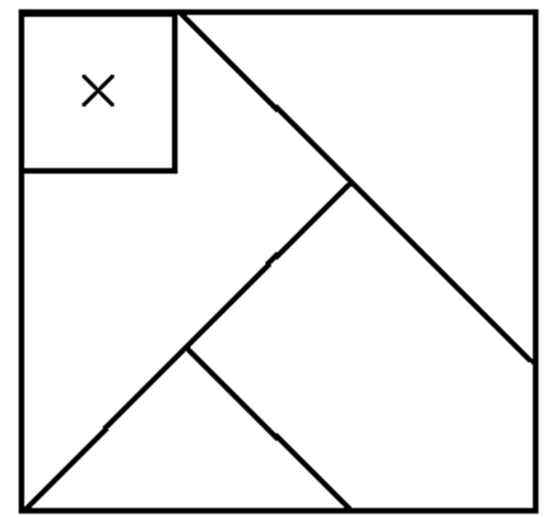
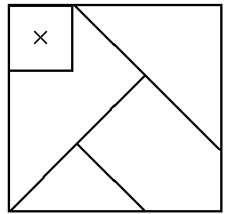

Slide 2
DO NOW: Science as a process!
Take a look at the pieces.
Each piece represents current scientific data.
Create a square using all your pieces
Go!

Slide 3
Objectives
Describe the scientific method as a “way to think”
Participate in an activity to “think” as a scientists and solve several puzzles
Write problem solving steps utilized during the activities

Slide 4
Scientific data

The Small square marked with an “X”
represents a new scientific discovery.
You must incorporate this new information to the puzzle.
If you gets the correct arrangement, cover up the answer until we discuss as a class.

Slide 5
Follow-Up Question
Brainstorm and share how this activity is similar to “doing” science.
Write the steps you followed in order to solve the problem

Slide 6
How does it do that!?
http://www.flashlightcreative.net/swf/mindreader/
http://www.queendom.com/tests/quiz/index.htm?idRegTest=764

Slide 7
Sunflower Monster!
1. Explain to a child how the seed became the huge plant! (1 paragraph)
Use evidence to back up your claims! Take a close look at the plant in front!
2. Think of an alternative theory that can explain how the plant came to be (non-science) (1 paragraph)
Think of how older civilizations would explain it (i.e. the gods came and…)

Slide 8
Inquiry Cube
What qualities do scientists have? What are scientists like?
Draw what a scientist looks like.
How do Scientist do their work? How would they describe a scientific investigation?
Notes:
Go around finding good behavior and group work skills during cube activity.

Slide 9
Inquiry Cube
Now that I have given you this cube - What are questions we can investigate about this cube?
Do not touch, turn, lift, or move the cube in any way.
Notes:
After settling on “what’s on the bottom” question write down quick guess and confidence level of what is on the bottom (to highlight idea of growing evidence increases confidence). Go around finding good behavior and group work skills during cube activity.

Slide 10
Inquiry Cube
What is on the bottom and how did you find out?
(How is it different than asking your best friend or looking something up on Wikipedia?)
Notes:
Go around finding good behavior and group work skills during cube activity.

Slide 11
Image
Draw a square in your notebook of what you think the bottom of the cube looks like.
How confident do you think your conclusion is correct?

Slide 12
Science is…
Science originates in questions about the world.
Science uses observations to construct explanations (answers to the questions). The more observations you had that support your proposed explanation, the stronger your explanation, even if you could not absolutely confirm the answer by examining the bottom of the cube.
Scientist make their explanations public through presentations at professional meetings and journals.
Scientists present their explanations and critique the explanations proposed by other scientists.

Slide 13
Inquiry Cube
First Hypothesis: (just guess) confidence:
Data:
Patterns:
Low
Medium
High

Slide 14
Inquiry Cube
Research groups publicly share your explanations.
9. What is the benefit to hearing other research groups’ ideas?
Notes:
Go around finding good behavior and group work skills during cube activity.

Slide 15
Inquiry Cube
Scientist use patterns in data to make predictions and then design an experiment to assess the accuracy of their prediction. This process can also produce additional data.
10. Use your observations (data) to make a prediction of the number in the upper-right corner of the bottom.
Notes:
Go around finding good behavior and group work skills during cube activity.

Slide 16
Inquiry Cube
11. Final Hypothesis confidence:
Low
Medium
High
Notes:
Go around finding good behavior and group work skills during cube activity.

Slide 17
Inquiry Cube
*12. Describe how your confidence changed from first hypothesis and final hypothesis and why?
*13. How is this activity like real science?
*14. What about science doesn’t this activity capture?
Notes:
Pencil and mirror are like technology, limited funding, don’t “absolutely know” the answer, confidence rose with evidence...
Short, we could possibly just look at bottom, …
Go around finding good behavior and group work skills during cube activity.

Slide 18
Paragraph
Science is finding patterns in nature and then using those patterns to accurately predict the future. For instance, one pattern in nature that nearly everyone has discovered is that objects on earth, when unsupported, fall. We have named this pattern gravity. And we can predict that tomorrow if you were to hold up a marker then let it go, that marker would fall to the floor. Now scientists and engineers have discovered many patterns and have gone as far as creating a device, from materials found in the earth’s crust, that if tomorrow you touch in a certain way and then talk towards it a loved one can hear your voice miles away! We, of course, call this amazing combination of stuff from the ground a cell phone.

Slide 19
