Slide 1
No Bones About it!
Bio Technology
AP Bio
Central Falls High School

Slide 2
Do Now
Do Now
Last one
WHAT?
Objectives
The case
History
Evidence
The Gel
Suspects
Closing
What is the use of electrophoresis?
How does electrophoresis work?

Slide 3
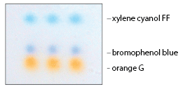
Conclusions from lab 1
You should have guessed that Xylene Cyanol was the largest from the results
BUT……. Bromophenol Blue has groups that make it very negatively charged so it is “pulled on” harder by the + electrode

Slide 4
Wait, What?
Do Now
Last one
WHAT?
Objectives
The case
History
Evidence
The Gel
Suspects
Closing
http://news.nationalgeographic.com/news/2012/01/120105-fish-mimics-octopus-kopp-science/

Slide 5
Objectives
Do Now
Last one
WHAT?
Objectives
The case
History
Evidence
The Gel
Suspects
Closing
SWBAT:
Set up an electrophoresis gel that can solve the crime of the stolen crown
Use biotechnology skills to investigate the way in which some crimes are solved using DNA evidence.

Slide 6
The Case
Do Now
Last one
WHAT?
Objectives
The case
History
Evidence
The Gel
Suspects
Closing
An irreplaceable item has gone missing! It is your job to find the guilty party and bring them justice.
You will do this by comparing DNA samples of 7 different suspects to the DNA found on the crime scene .
Please use the biotechnology skills that you currently have to carefully load an electrophoresis gel with the all the DNA samples (one from the crime scene and all the suspects).

Slide 7
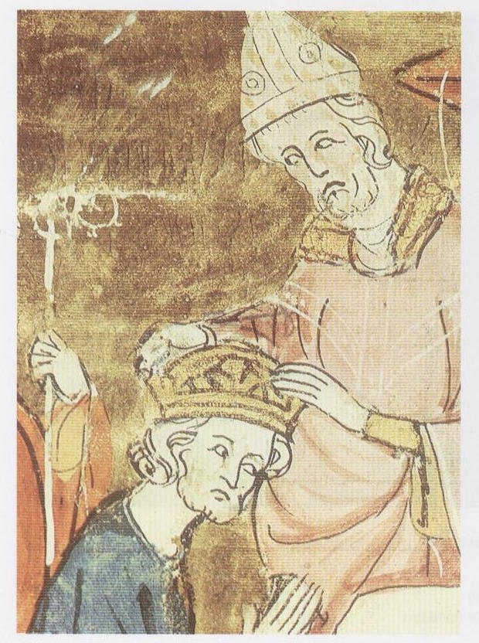
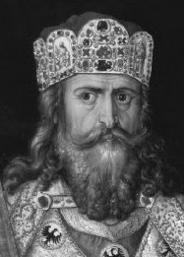
A little History
Charlemagne (CHARLES THE GREAT)
King of the Franks from 768 and Emperor of the Romans (Imperator Romanorum) from 800 to his death in 814.
Was crowned Imperator Augustus by Pope Leo III on 25 December 800

Slide 8
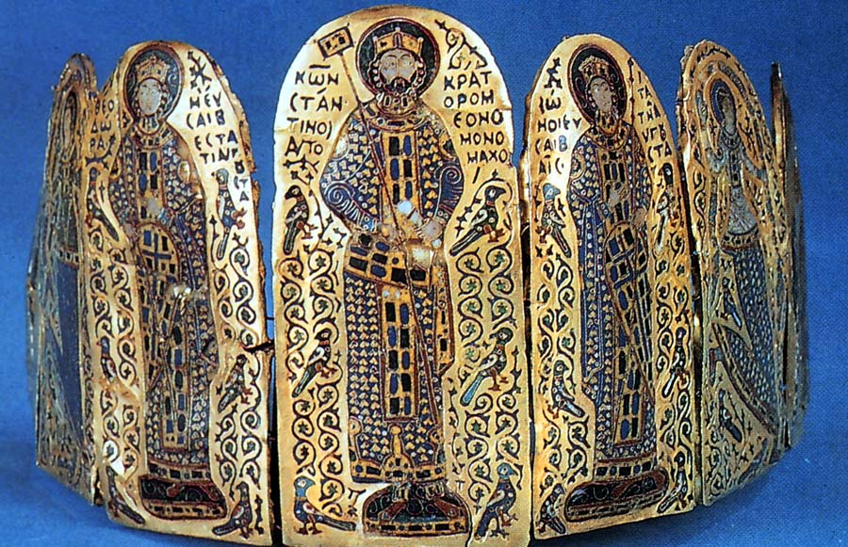
The missing Crown!
Do Now
Last one
WHAT?
Objectives
The case
History
Evidence
The Gel
Suspects
Closing

Slide 9
Intro
Do Now
Last one
WHAT?
Objectives
The case
History
Evidence
The Gel
Suspects
Closing
People with lots of money, buy expensive things
We are looking into a crime from Newport RI (some people there have LOTS of money – and therefore expensive things)
The victim is J.van der Gleason
The missing item is the Charlemagne crown

Slide 10
The Suspects
Do Now
Last one
WHAT?
Objectives
The case
History
Evidence
The Gel
Suspects
Closing
Porterford: the butler
Colonel Hornblower: Army officer,
retired
Franz: the chef
Vance: the chauffeur
Martini: the carpenter
Señorita Esmerelda: the maid
Juan: the gardener

Slide 11
Evidence!
Please take two minutes and list ALL the potential evidence that a detective may look for in order to find a guilty criminal:
Circumstantial
Physical
Notes:
Students first think of the concept of “evidence” in pairs and then we have a brainstrom session on the board, listing everything down – a natural group happens with two kinds of evidence: physical and circumstantial.

Slide 12
Materials:
Do Now
Last one
WHAT?
Objectives
The case
History
Evidence
The Gel
Suspects
Closing
Metric Rulers
Handouts with suspect profiles
Electrophoresis gels
DNA samples
One from the crime scene
One from each of the suspects

Slide 13
For today!
Do Now
Last one
WHAT?
Objectives
The case
History
Evidence
The Gel
Suspects
Closing
Set up the electrophoresis gels (prepare and pour)
Make enough buffer solution to run the gels
Discuss in your group all the suspects, come up with a logical argument to why there is a higher likelihood for one of them to be found guilty.
Please be sure to have an explanation for your choice and the evidence you will use to demonstrate their crime. Write this paragraph on the back of the handout and be ready to share with the rest of the class!

Slide 14
Do Now
Do Now
Last one
WHAT?
Objectives
The case
History
Evidence
The Gel
Suspects
Closing
What are some examples of circumstantial evidence?
How often do you think that DNA evidence is used in criminal prosecutions?
Notes:
DNA evidence has rapidly become a significant and routine feature of modern criminal prosecutions. The
first introduction of DNA evidence in a U.S. Court occurred in 1987. By 1994, 42 percent of local prosecutors reported that they had used DNA evidence in
a felony case at least once. By 2001 that number had increased to 68 percent.
http://www.denverda.org/DNA_Documents/Use%20of%20Forensic%20DNA%20in%20Prosecutors'%20Offices.pdf

Slide 15
Procedure
Do Now
Last one
WHAT?
Objectives
The case
History
Evidence
The Gel
Suspects
Closing
Each table will have one electrophoresis chamber.
The four students per table will break up into two groups with each group having there own gel wells.
The first group students will run solutions A, B, C of the suspects and CS (DNA left at the crime scene).
The second group will run D, E, F, and G of the remaining suspects.
When the activity is completed, the two groups will compare their results to determine who left the blood sample on the glass shard.

Slide 16
DNA sample labels
Do Now
Last one
WHAT?
Objectives
The case
History
Evidence
The Gel
Suspects
Closing
CS Crime scene DNA
A Porterford; the butler
B Colonel Hornblower; Army officer, retired
C Franz; the chef
D Vance; the chauffeur
E Martini; the carpenter
F Senorita Esmerelda; the maid
G Juan, the gardener

Slide 17
Loading the Gels
Do Now
Last one
WHAT?
Objectives
The case
History
Evidence
The Gel
Suspects
Closing
Group 1:
Well 1 add 10 uL sample CS
Well 3 add 10 uL sample A
Well 5 add 10 uL sample B
Well 7 add 10 uL sample C
Group 2:
Well 1 add 10 uL sample D
Well 3 add 10 uL sample E
Well 5 add 10 uL sample F
Well 7 add 10 uL sample G

Slide 18
Do Now
Last one
WHAT?
Objectives
The case
History
Evidence
The Gel
Suspects
Closing
What are some DNA uses in Forensic Identification?
Notes:
http://www.ornl.gov/sci/techresources/Human_Genome/elsi/forensics.shtml
Identify potential suspects whose DNA may match evidence left at crime scenes
Exonerate persons wrongly accused of crimes
Identify crime and catastrophe victims
Establish paternity and other family relationships
Identify endangered and protected species as an aid to wildlife officials (could be used for prosecuting poachers)
Detect bacteria and other organisms that may pollute air, water, soil, and food
Match organ donors with recipients in transplant programs
Determine pedigree for seed or livestock breeds
Authenticate consumables such as caviar and wine

Slide 19
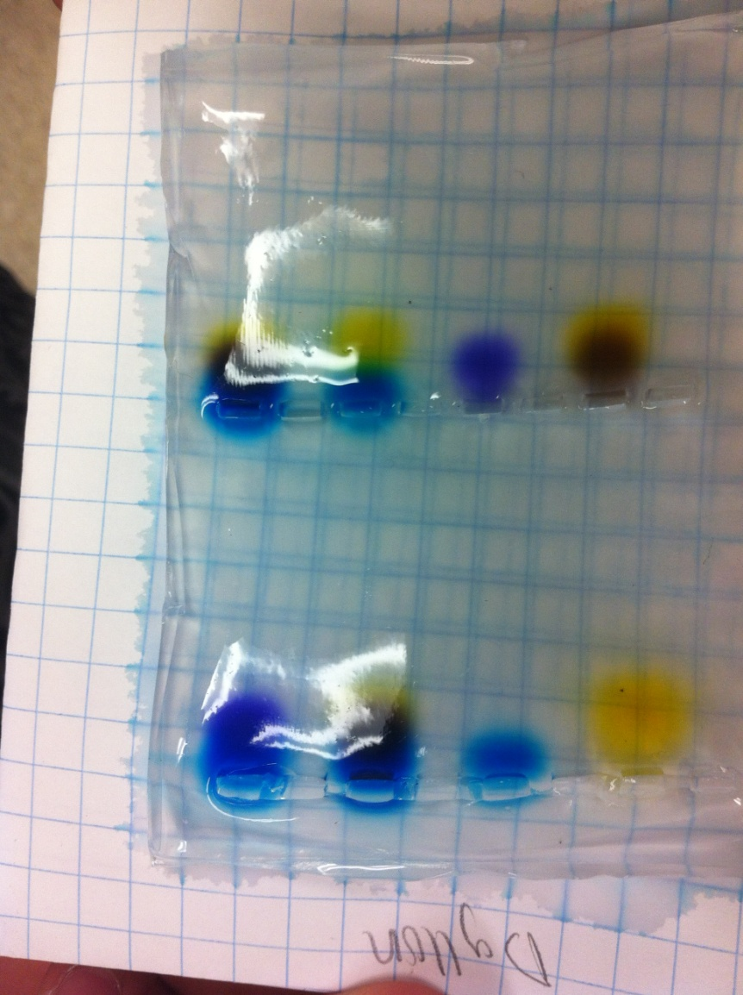

Slide 20
Post-Lab Questions
Do Now
Last one
WHAT?
Objectives
The case
History
Evidence
The Gel
Suspects
Closing
Compare the dyes in the lanes of both wells to determine whose DNA matches the sample left at the crime scene. Who committed the crime?
The crime scene suspect left behind a sample of blood at the crime scene that was used to construct a DNA profile of the thief. Are there other ways that the perpetrator could have left a DNA sample for forensic Identification?
Besides DNA evidence, list other types of non DNA evidence that a crime suspect could leave behind that might be used as forensic evidence?

Slide 21
Closing
Do Now
Last one
WHAT?
Objectives
The case
History
Evidence
The Gel
Suspects
Closing
Did we do this?
Set up an electrophoresis gel that can solve the crime of the stolen crown
Use biotechnology skills to investigate the way in which some crimes are solved using DNA evidence.

Slide 22
The Case of the Missing Crown Answers
The solutions contain various combinations of Bromophenol blue (purple), Xylene cyanole (blue), and Orange G (orange).
Suspect Colors on Gel
A Porterford; the butler - Orange, purple
B Colonel Hornblower ; Army officer, retired – Blue
C Franz; the cook - Orange, purple
D Vance; the chauffer - Blue purple
E Martini; the carpenter - Orange, purple, blue
F Senorita Esmeralda; the maid - Purple
G Juan; the gardener - Orange
E Crime Scene - Orange, purple, blue

Slide 23
Some Examples of DNA Uses for Forensic Identification
Identify potential suspects whose DNA may match evidence left at crime scenes
Exonerate persons wrongly accused of crimes
Identify crime and catastrophe victims
Establish paternity and other family relationships
Identify endangered and protected species as an aid to wildlife officials (could be used for prosecuting poachers)
Detect bacteria and other organisms that may pollute air, water, soil, and food
Match organ donors with recipients in transplant programs
Determine pedigree for seed or livestock breeds
Authenticate consumables such as caviar and wine

Slide 24
Is DNA effective in Identifying persons?
DNA Identification can be quite effective if used intelligently. Portions of the DNA sequence that vary the most among humans must be used; also, portions must be large enough to overcome the fact that human mating is not absolutely random.
Consider the scenario of a crime scene investigation…
Assume that type O blood is found at the crime scene . Type O occurs in about 45% of Americans. If investigators type only for ABO, finding that the “suspect" in a crime is type O really doesn’t reveal very much.
If, in

