Slide 1
Microscope
1. Magnification: the amount the specimen is enlarged
2. Resolution: Clarity of the image

Slide 2
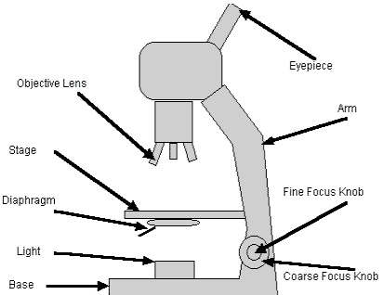

Slide 3
Prokaryotic vs. Eukaryotic

Slide 4
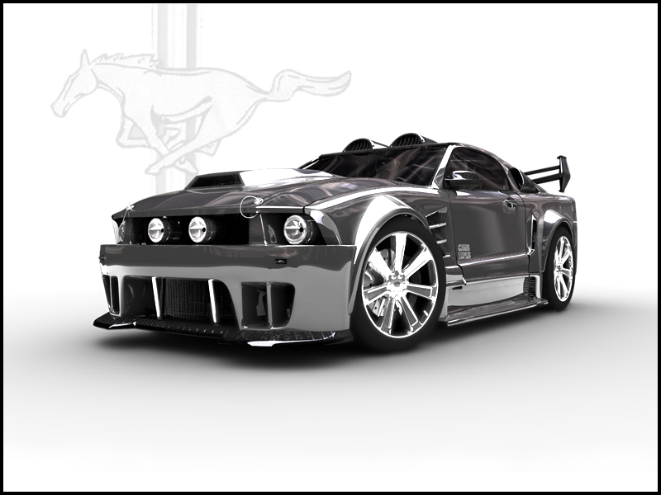
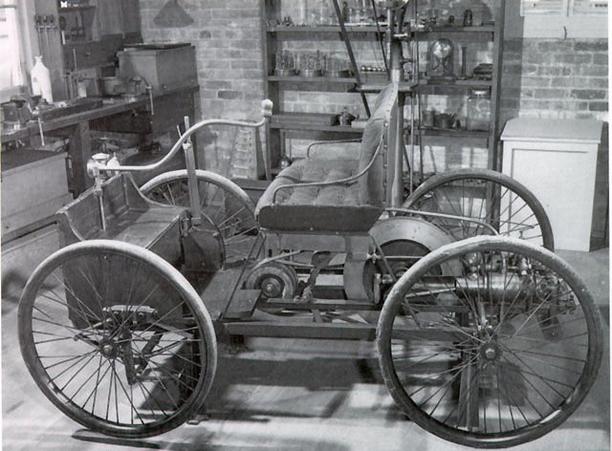
Prokaryotic vs. Eukaryotic

Slide 5
Organelles
Cell (Plasma) membrane: An outer boundary that allows certain things to come through, certain things to go out, ( selectively permeable) but basically keep the cell together.
The cell membrane is made up of a phospholipids bilayer
This forces the “tails” to be repelled to the middle of the bi-layer
Can contain: enzymes, transporters, markers

Slide 6
More Organelles
Nucleus: “brain” that controls cell activities and where DNA is stored.
Cytoskeleton: Small fibers within the cytoplasm that help to maintain cell shape and size. (made of microtubules and microfilaments
Ribosomes: Makes proteins

Slide 7
Even More Organelles
Golgi apparatus: Modifies and sends proteins out
Mitochondria: Takes energy from food to produce ATP

Slide 8
Plant Cells
Chloroplasts
Cell Wall
Vacuole

Slide 9
How do you like me now?
Do you now know about?:
Microscope (label parts)
Magnification/Resolution
Prokaryotic and Eukaryotic
Organelles
Plant versus animal cells

Slide 10
Closing/Homework
Can you do this now?
Explain the functions of organelles found within the eukaryotic cell;.
Recognise the difference between plant cells and animal cells.
Homework: Chapter 3-3 Homework!

