Slide 1
Do Now
Do Now
Objectives
Groups
Specimens
Reading
Outside
Closing
Please take 2 minutes to answer these questions:
How do we study the natural world?
How can we test our observation skills?

Slide 2
Objectives
Do Now
Objectives
Groups
Specimens
Reading
Outside
Closing
By the end of today’s class you will be able to:
Describe observations of specimens and make inferences about them
Complete handout including diagram
Look up information about biological specimens

Slide 3
Working groups
Do Now
Objectives
Groups
Specimens
Reading
Outside
Closing
You will work with a partner
You have to complete all the required parts in the handout!
Be prepared to participate in your activities

Slide 4
Do Now
Objectives
Groups
Specimens
Reading
Outside
Closing
In the next 5 minutes:
Draw an ANT from memory!
Be ready to share
Do NOT cheat by looking it up!

Slide 5
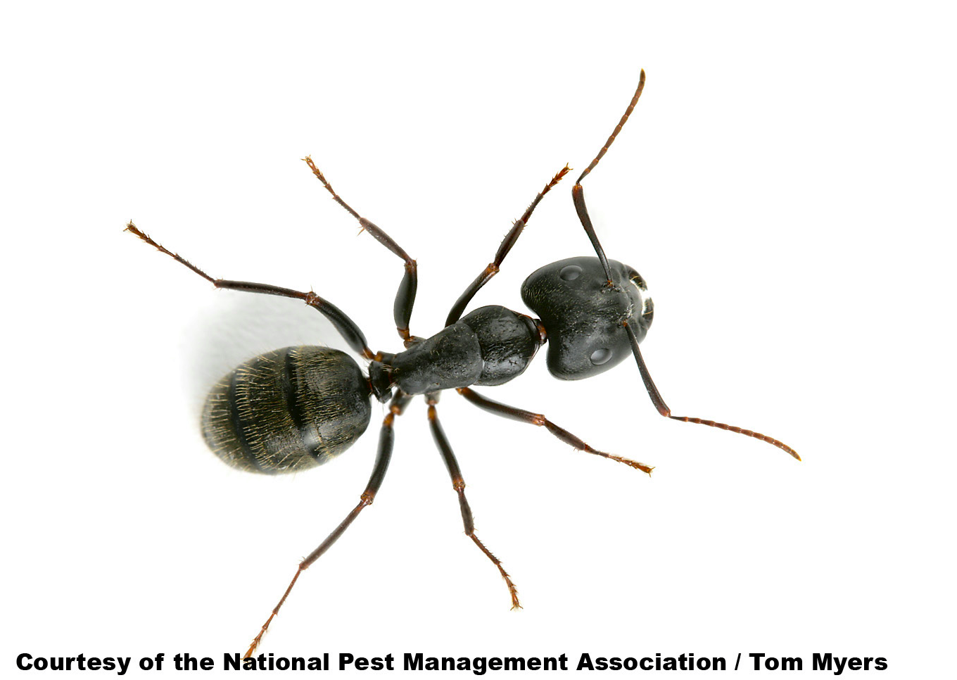
Compare it to this:
Do Now
Objectives
Groups
Specimens
Reading
Outside
Closing

Slide 6
Step 1. Make observations
Do Now
Objectives
Groups
Specimens
Reading
Outside
Closing
The first step in the Scientific Method is to make objective observations.
These observations should be objective, not subjective. In other words, the observations should be capable of verification by other scientists. Subjective observations (personal opinions and beliefs) are not in the realm of science.
Objective : It is 60 °F in this room vs. Subjective : It is cool in this room.

Slide 7
Closing/Homework
Do Now
Objectives
Groups
Specimens
Reading
Outside
Closing
Can you do this now?
Describe observations of specimens and make inferences about them
Complete a reading guide for the introduction of biology
Take part in a scientific discussion
Homework: binders with paper and parent survey!

